Slide 1
4. Connector Operations
ADVANCED
OPERATIONS
TRAINING
© Copyright Scality 2022
RING 8.5

Slide 2
Connector Operations
At the end of this module, you will be able to …
… understand your connectors architecture
… and also operate and check the connector services.
Notes:
Last update: 20180410

Slide 3
Contents
The first thing
also this
and this
That other thing
with this
and this

Slide 4
S3 Connector Operations
S3 7.10

Slide 5

S3C Architecture
5x stateful S3 MD cluster members*
Load Balancer
Nx stateless S3 servers**
S3 Server (S3 API)
redis
(cluster)
UTAPI
DATA RING
Vault
(vault metadata cluster)
repd
LevelDB
sproxyd***
bucketd
(bucket metadata cluster)
repd
repd
repd
repd
LevelDB
repd
repd
repd
repd
Kudzu
BackBeat - populators - processors
BackBeat - queue (Kafka) - quorum
Notes:
(*) Additional Warm Stand-by stateful are common especially in stretched architectures
(**) N = number of DATA storage servers. More on some architectures
(***) There are 4x sproxyds per S3 connector, for load-balancing

Slide 6
S3C Architecture
Authentication through Vault.
S3 uses bucketd for metadata (buckets and objects lists).
Leverages Backbeat for metadata updates queuing.
RAFT consensus mechanism for DB sync in the repd metadata clusters.
S3 pushes data to the RING through sproxyd.
Health checks thanks to Kudzu and ElasticSearch.
Utilization tracking and metrics reporting with UTAPI.
Clusters of 5 stateful metadata S3 connectors.
Typically on storage servers.

Slide 7
HTTP Load Balancing
Load balancing is mandatory for the S3 connectors.
Scality doesn’t provide a Load Balancer for those connector, but can assist the deployment of one.
Load balancing for S3C supports Round Robin and other load balancing algorithms (least connections, adaptive, weighted, etc).
For HTTPS, both Load Balancer-side and connector-side SSL termination are supported.

Slide 8
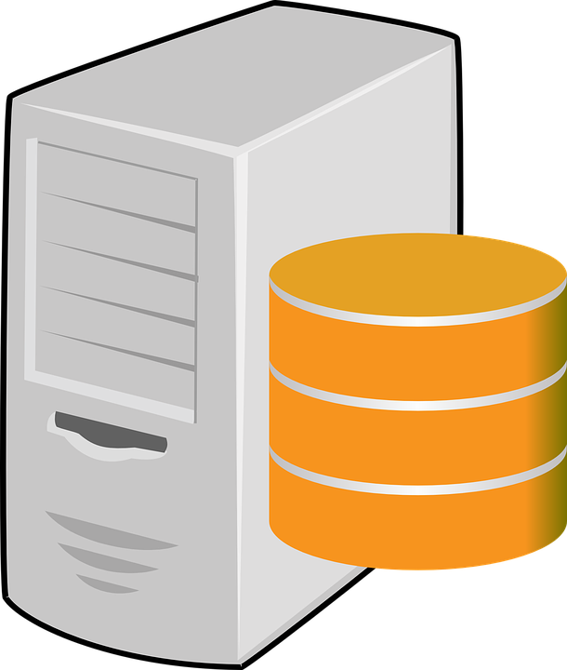


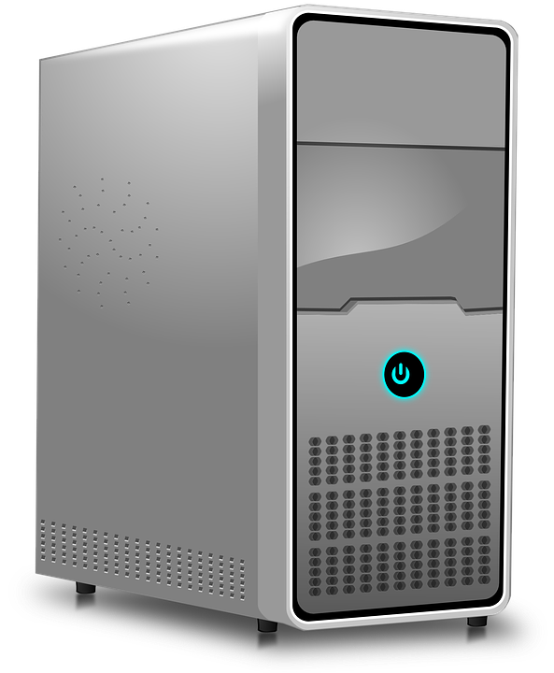
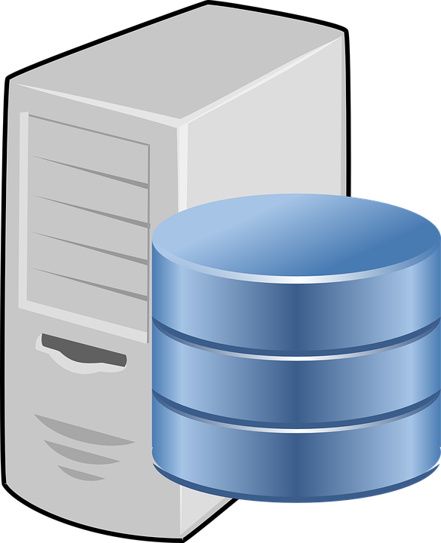

RAFT Update Workflow
Seq X: entry
Seq X: entry
Seq X: entry
Seq X: entry
RAFTLOG
Leader
RAFTLOG
Late Follower
Seq X: entry
Seq X: entry
RAFTLOG
Up-to-date Follower

Slide 9
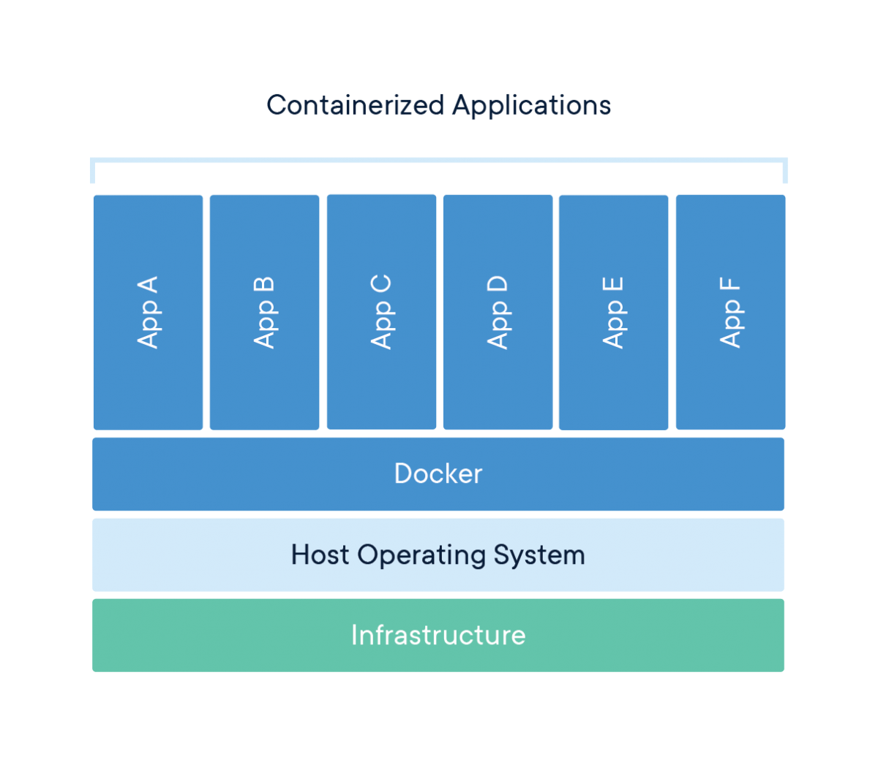
Docker Containers
A container is a standard unit of software that packages up code and all its dependencies so the application runs quickly and reliably from one computing environment to another.
A Docker container image is a lightweight, standalone, executable package of software that includes everything needed to run an application: code, runtime, system tools, system libraries and settings.
More on 🔗What is a container?

Slide 10
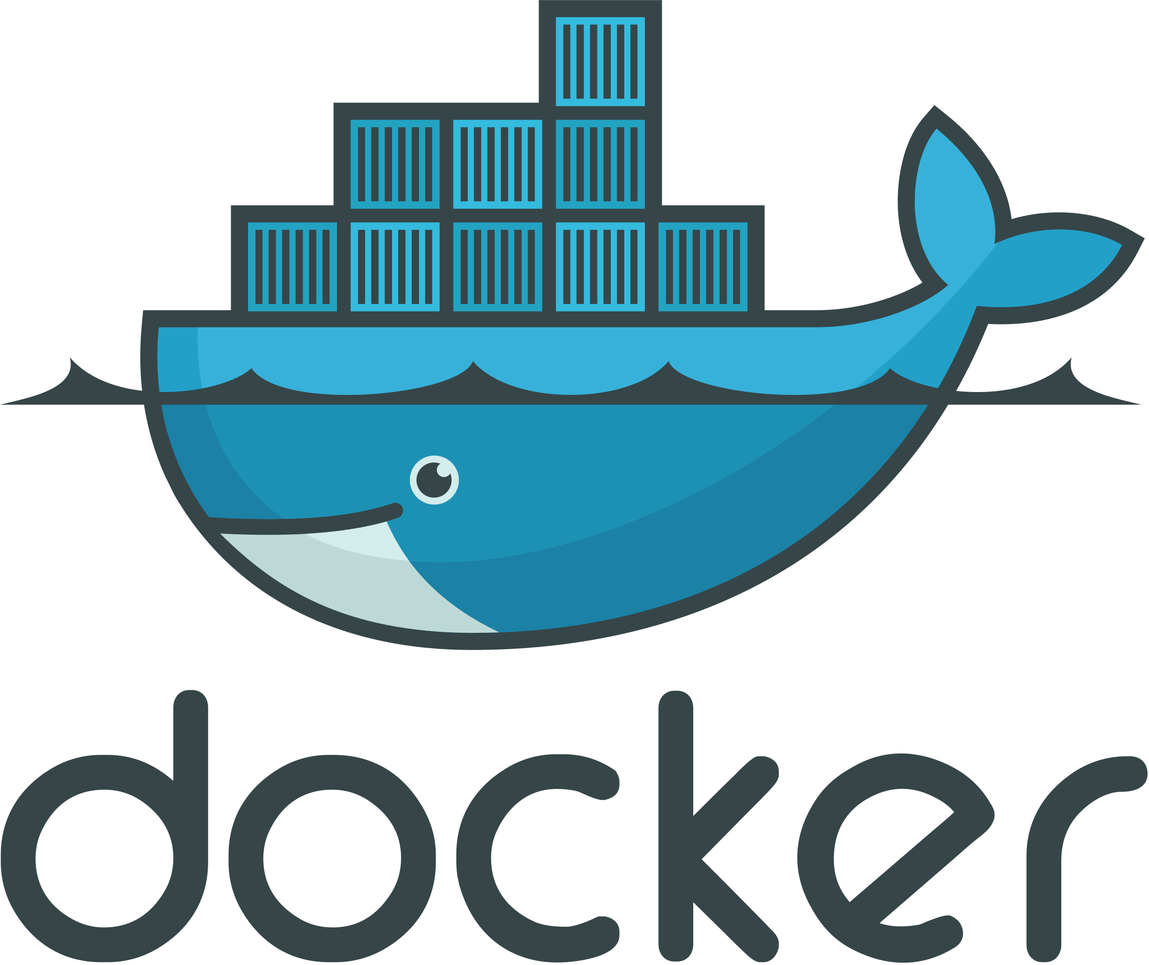
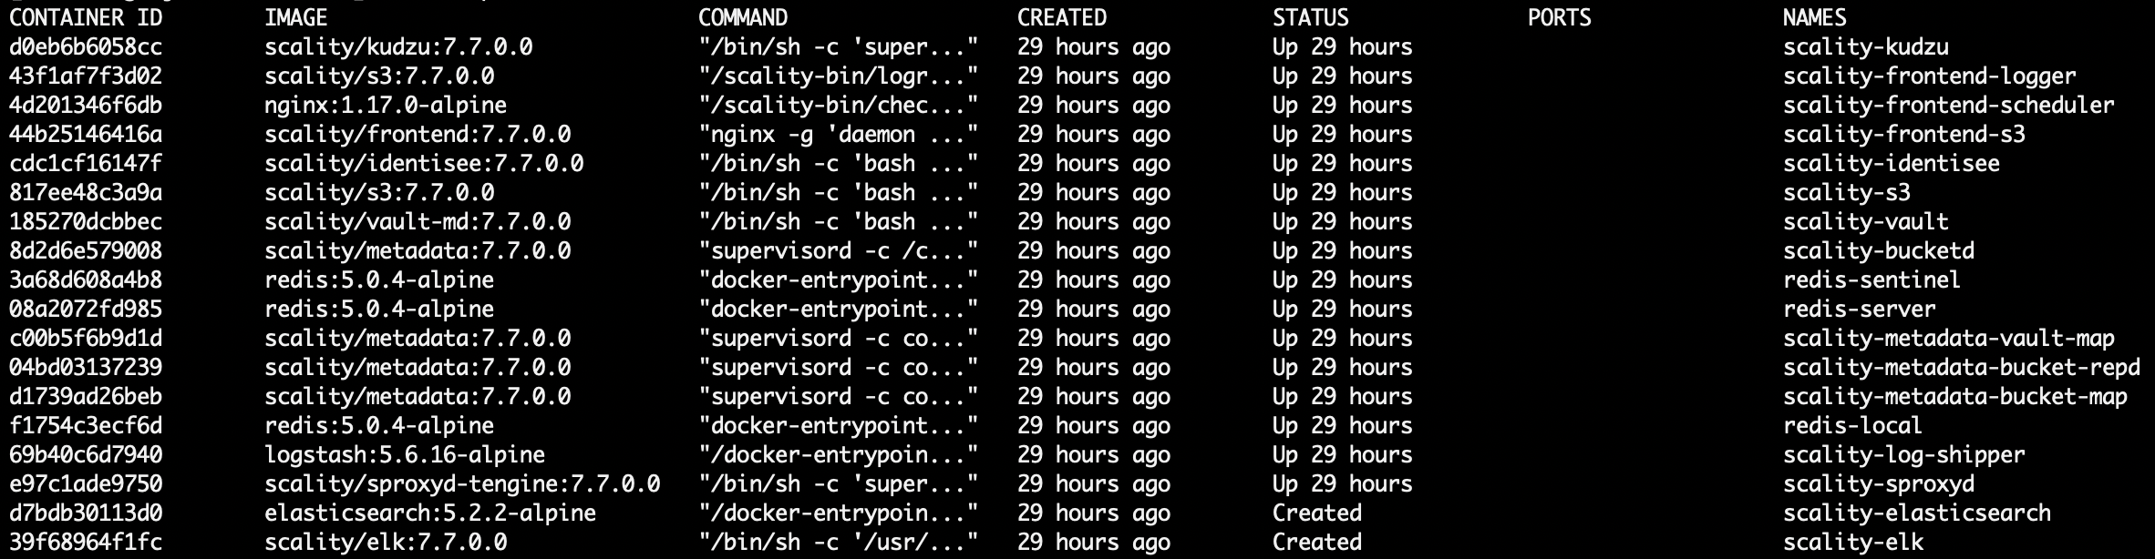
S3C Containers
The S3 Connector stack uses, modules run in an abstraction called a container.
When service is healthy STATUS uptimes are all the same.
For more about the Scality Docker images, check out “Docker Images” in the Scality S3 Connector Operation guide found on 🔗https://documentation.scality.com.

Slide 11
S3 Connector Operations
As S3C is deployed as a cluster, it is more convenient to run operations from the Supervisor.
Stopping all containers on a specific S3 Connector (CentOS|RedHat 7):
Starting all containers on a specific S3 Connector (CentOS|RedHat 7):
Stopping all containers on all S3 Connectors (CentOS|RedHat 7):
Starting all containers on all S3 Connectors (CentOS|RedHat 7):
S3C also comes with Ansible, which can be used alternatively. Eg: checking all container statuses on all S3 Connectors (this is one single line):
salt <machine_minion_name> cmd.shell 'docker ps -q -a | xargs -r docker stop'
salt <machine_minion_name> cmd.shell 'docker ps -q -a | xargs -r docker start'
salt -G 'roles:ROLE_S3' cmd.shell 'docker ps -q -a | xargs -r docker stop'
salt -G 'roles:ROLE_S3' cmd.shell 'docker ps -q -a | xargs -r docker start'
/srv/scality/s3/s3-offline/repo/venv/bin/ansible -i \
/srv/scality/s3/s3-offline/federation/env/<my_env>/inventory all -m command -a 'docker ps'

Slide 12
S3 Connector Operations (2)
Running checks
Checking all container statuses on a specific S3 Connector (CentOS|RedHat 7):
Checking all container statuses on all S3 Connectors (CentOS|RedHat 7):
Checking the S3 Server on a specific S3 Connectors (CentOS|RedHat 7): ➥ Example of a typical output:
salt <machine_minion_name> cmd.shell 'docker ps'
salt -G 'roles:ROLE_S3' cmd.shell 'docker ps'
salt <machine_minion_name> http.query status=True http://127.0.0.1:8000/_/healthcheck/deep
store-0:
----------
body: {"us-west-1":{"code":200,"message":"OK"},"eu-central-1":{"code":200,"message":"OK"},"ap-northeast-1":{"code":200,"message":"OK"},"sa-east-1":{"code":200,"message":"OK"},"ap-northeast-2":{"code":200,"message":"OK"},"ap-southeast-1":{"code":200,"message":"OK"},"us-east-1":{"code":200,"message":"OK"},"ap-south-1":{"code":200,"message":"OK"},"eu-west-2":{"code":200,"message":"OK"},"dc1":{"code":200,"message":"OK"},"us-west-2":{"code":200,"message":"OK"},"us-east-2":{"code":200,"message":"OK"},"ap-southeast-2":{"code":200,"message":"OK"},"EU":{"code":200,"message":"OK"},"dc1-rr":{"code":200,"message":"OK"},"cn-north-1":{"code":200,"message":"OK"},"eu-west-1":{"code":200,"message":"OK"},"sproxyd":{"code":200,"message":"OK"},"ca-central-1":{"code":200,"message":"OK"},"bucketclient":{"code":200,"message":"OK","body":{}},"vault":{"code":200,"message":"OK","body":{}}}
status:
200

Slide 13
S3 Connector Operations (3)
S3C Probe URLS
Similar to the last command on the previous slide, HTTP checks can use the following URLS to:
Check the Metadata bucketd daemon status:
Check vaultdb Vault daemon status:
Probes to port 8500 are for setup, when only internal communication routes are available:
Probes to port 8600 are for IAM administration once IAM and vaultclient are up:
Check Backbeat’s status:
Checks Service Utilization API (UTAPI) status:
For more on S3C probes, look up “S3 Connector Component Probes” in the S3 Connector Operation guide found on 🔗https://documentation.scality.com.
http://127.0.0.1:9000/_/healthcheck
http://127.0.0.1:8500/_/healthcheck
http://127.0.0.1:8600/_/healthcheck
http://127.0.0.1:8900/_/healthcheck
http://127.0.0.1:8100/_/healthcheck
Notes:
Checks details:
HTTP9000: checks if the Metadata bucketd daemon has leader information for all map and RAFT sessions
HTTP8500/HTTP8600: checks if leader info exists for the vaultdb Vault daemon:
Probes to port 8500 are for setup, when only internal communication routes are available
Probes to port 8600 are for IAM administration once IAM and vaultclient are up
HTTP8900: checks if Backbeat’s use of Kafka and its topics is healthy:
HTTP8100: checks if the Service Utilization API (UTAPI) is connected to the Redis Sentinel leader:

Slide 14
S3 Connector Logs
On the S3C Machines
[root@store-0 ~]# cd /var/log/s3
[root@store-0 s3]# ls -l
total 0
drwxr-xr-x 3 scality scality 18 Jul 23 07:48 scality-bucketd
drwxr-xr-x 3 scality scality 18 Jul 23 07:42 scality-elk
drwxr-xr-x 3 scality scality 18 Jul 23 07:51 scality-frontend-s3
drwxr-xr-x 3 scality scality 18 Jul 23 07:50 scality-identisee
drwxr-xr-x 3 scality scality 18 Jul 23 07:53 scality-kudzu
drwxr-xr-x 3 scality scality 18 Jul 23 07:43 scality-metadata-bucket
drwxr-xr-x 3 scality scality 18 Jul 23 07:44 scality-metadata-vault
drwxr-xr-x 3 scality scality 18 Jul 23 07:50 scality-s3
drwxr-xr-x 3 scality scality 18 Jul 23 07:43 scality-sproxyd
drwxr-xr-x 3 scality scality 18 Jul 23 07:48 scality-vault
[root@store-0 s3]# ls -l scality-frontend-s3/logs/*.log
-rw-r----- 1 scality scality 0 Jul 28 00:05 scality-frontend-s3/logs/backbeat-frontend-http.err.log
-rw-r----- 1 scality scality 0 Jul 28 00:05 scality-frontend-s3/logs/backbeat-frontend-http.log
-rw-r----- 1 scality scality 0 Jul 28 00:05 scality-frontend-s3/logs/s3-browser.err.log
-rw-r----- 1 scality scality 0 Jul 28 00:05 scality-frontend-s3/logs/s3-browser.log
-rw-r--r-- 1 scality scality 3110016 Jul 28 02:03 scality-frontend-s3/logs/s3-frontend-check.log
-rw-r----- 1 scality scality 0 Jul 28 00:05 scality-frontend-s3/logs/s3-frontend-http.err.log
-rw-r----- 1 scality scality 341857 Jul 28 02:03 scality-frontend-s3/logs/s3-frontend-http.log
-rw-r--r-- 1 scality scality 0 Jul 28 00:05 scality-frontend-s3/logs/s3-frontend-logrotate.log
[root@store-0 s3]#

Slide 15
Monitoring S3C
S3 Healthcheck
The S3 stack is comprised of several microservices
The healthcheck URL monitors the entire S3 stack
S3 Request Latencies

Slide 16
S3C Connector Operations Exercise

Slide 17
Exercise
Using s3cmd, upload a file with a size between 180KB and 6MB.
What S3 server has been used for this operation?
How much time did the operation take from the S3 POV? What is the S3 req_id?
What is the input key of the object?
What sproxyd process on the server processed the data of the operation?
What are the keys of the ARC chunks of this object?
What are the node processes responsible of the ARC chunks of this object?
What are the disks storing the ARC chunks of this object?
How much time did it take for each node to send the ARC chunks to the disks?
For help, see Hints in the next slide.
S3 Client/App
LB (haproxy)
S3C #1
S3C #2
S3C ?: 1.
S3C #3
S3C #4
S3C #5
S3C #6
x6 keys: 5.
DATA RING
t=?: 2.
nodes ?: 6.
node-1
node-2
node-3
node-4
node-5
node-6
disks ?: 7.
t=?: 8.

Slide 18
Exercise Hints
💡salt is your friend
On the S3C server, the S3 requests received on the frontend are logged in: /var/log/s3/scality-s3/logs/s3-0.log.
Same as 1.
nginx is the local load-balancer for the four local sproxyds and logs in /var/log/s3/scality-sproxyd/logs/nginx-0.log; the input key appears in some some sort of path.
sproxyd logs: /var/log/s3/scality-sproxyd/logs/sproxyd-*.log.
Combination of:
Finding the RING data key of the object, which matches the first ARC part (from the server from 1.):
Computing the keys of the other parts:
(how to use it ?).
Node processes log data operations to the disks in: /var/log/scality/node/chunkapi-node-*.log.
Same as 7.
curl -s '0:8181/dc1/.diagnose?key=<INPUT_KEY_FROM_3.>&verbose=1' | jq -r
ringsh key replicas <selected data key>
ringsh supervisor findAllReplicas

Slide 19

QUESTIONS ?

